Slide 1

My Stress Relief Website
By Payton Bramer

Slide 2
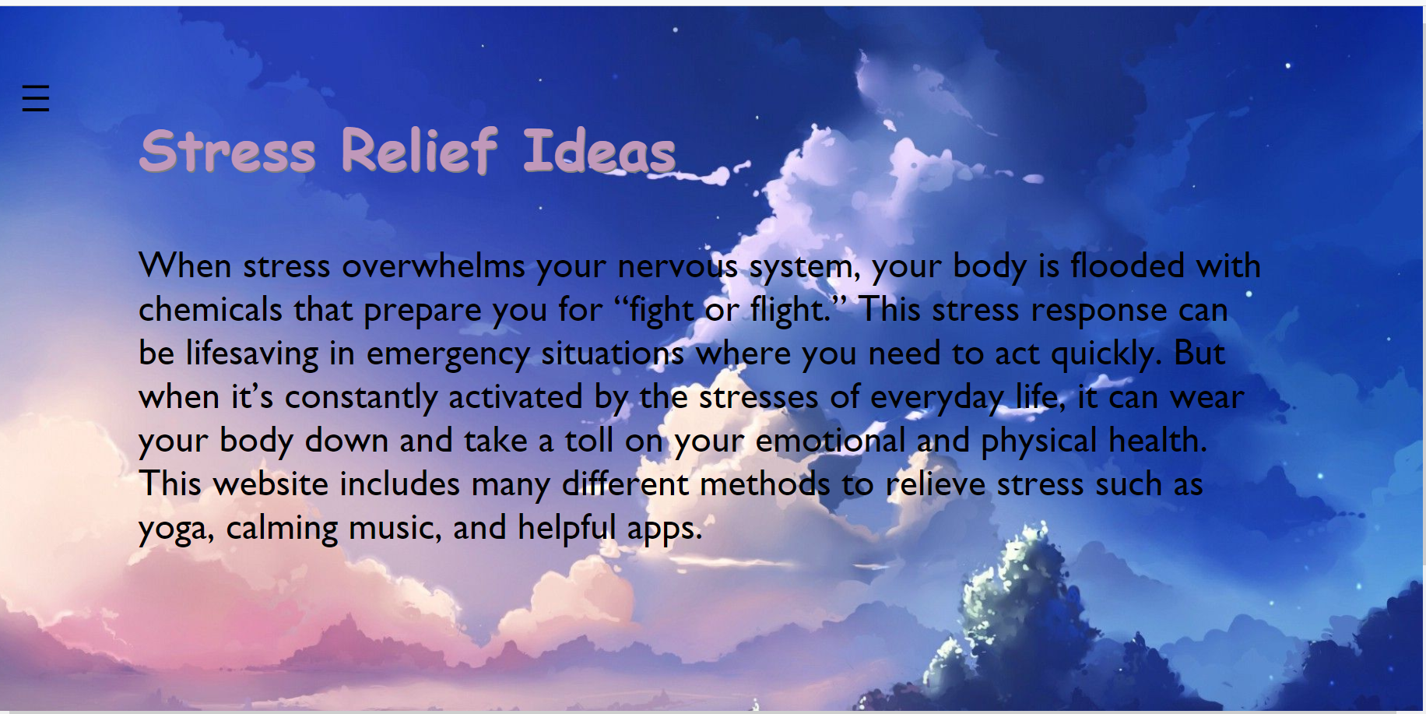
What’s the purpose?
The Purpose of the website is to provide remedies for stress and anxiety.

Slide 3
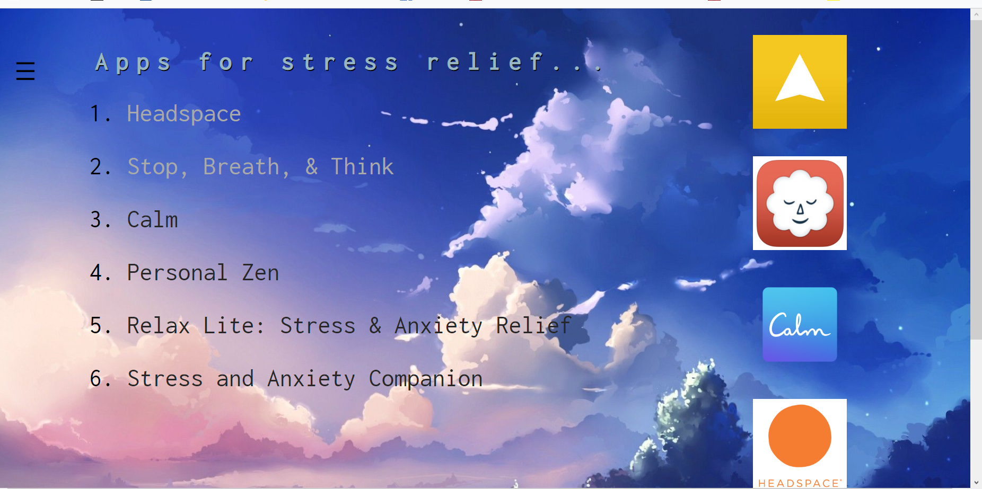
Who is the intended audience
The intended audience is any one who is struggling with anxiety or who is extremely stressed.

Slide 4
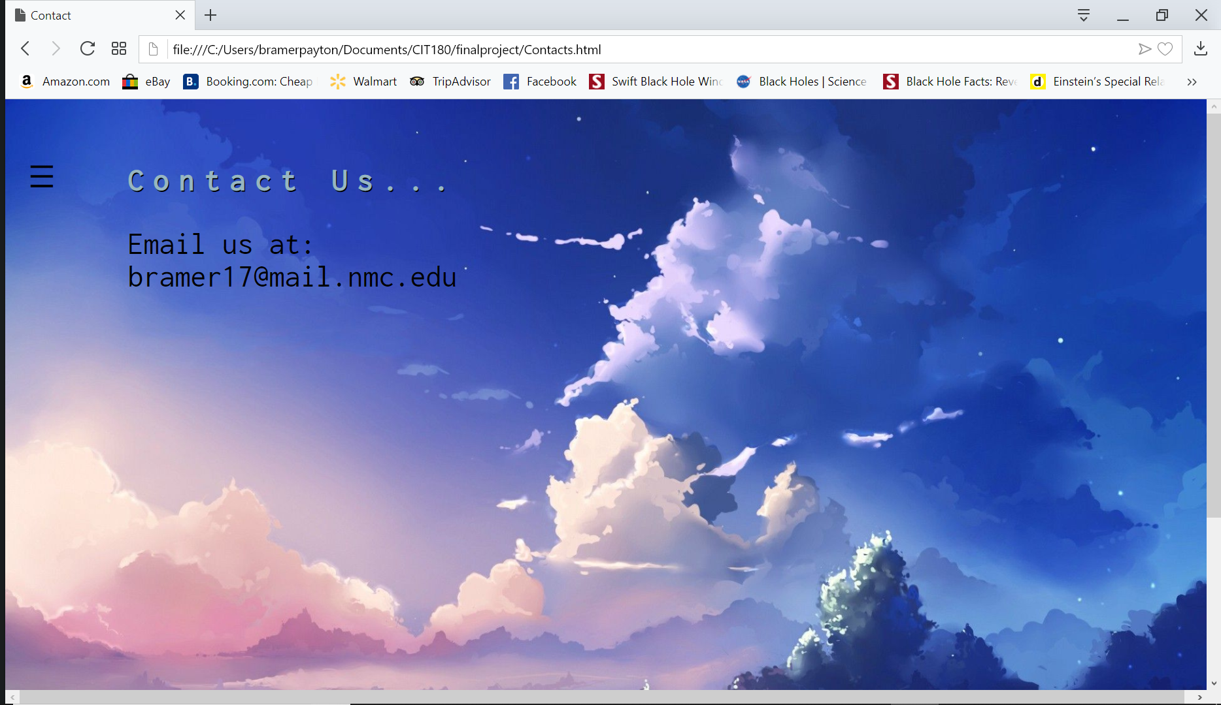
Color Schemes used and why I chose the colors?
I went with a purple, blue, and pink color scheme. I choose these colors because I felt they where calm and not to overwhelming. As well as I felt keeping it light would bring a tranquil mood to the website.

Slide 5
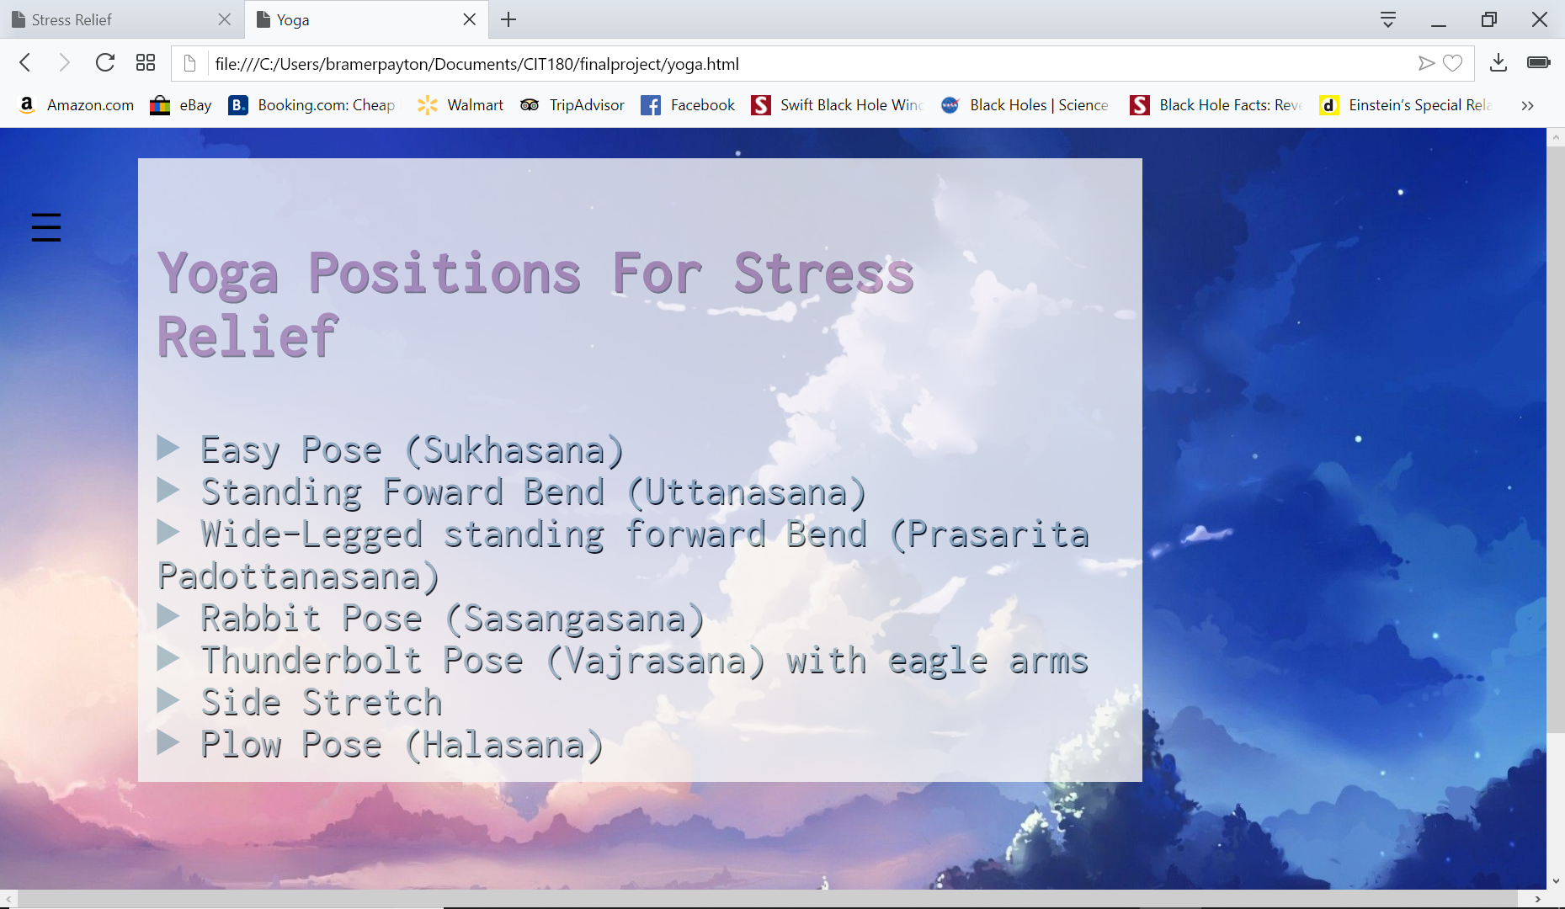
Layout and Design used AND why you selected them.
I used the push menu because I really liked how clean and professional it looked. I felt that having each menu choice take you to a different stress relief made the website cleaner and organized. I also used grid- view because I needed to work on it and felt this was a great chance.

Slide 6
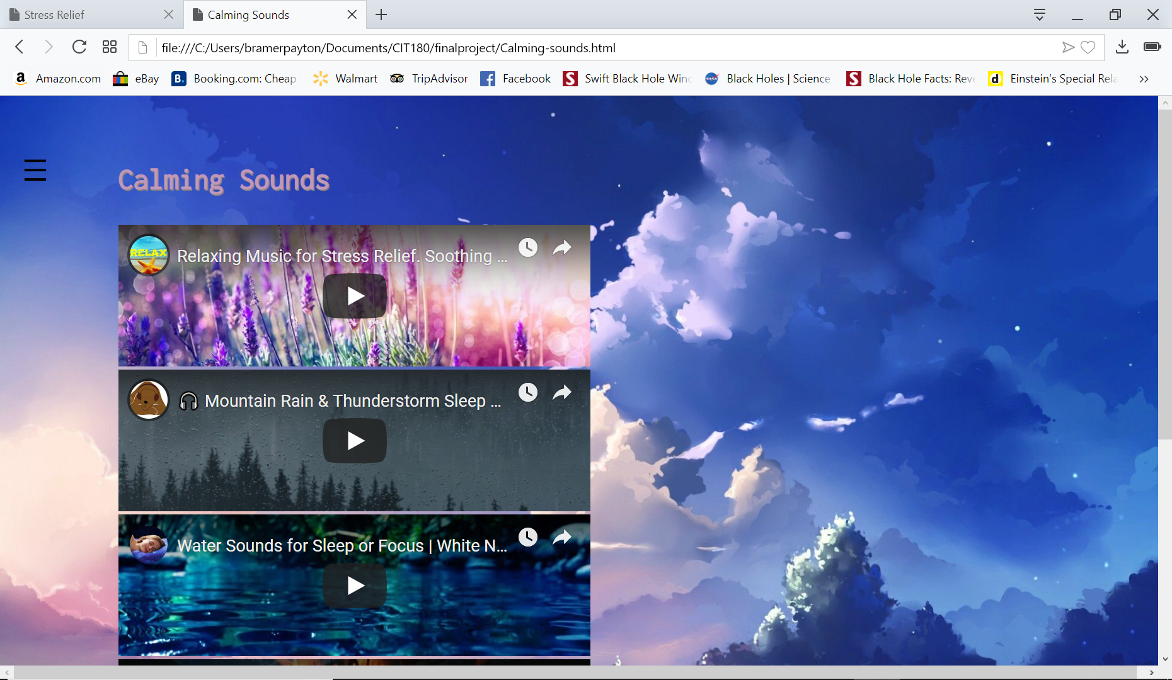
Challenges you faced implementing the design and how you overcame the challenges.
The first challenge I had was I messed with the code when trying to add pictures and text and the whole layout of the site got divided into three areas and it looked awful. I had to compare my code to the original push menu code to figure out the problem.
My second issue was I forgot how to make the pictures appear next to each other instead of underneath one another. I figured it out by looking back on previous code. After completing I didn’t like how it looked and decided to go a different route.

Slide 7

What you did well.
I felt I did a good job at coming up with a layout, design, and colors to go with the theme. I also feel I did well at incorporating all the different types of information. Such as videos, app links, and yoga positions. I’m extremely happy with how the website looks.

Slide 8
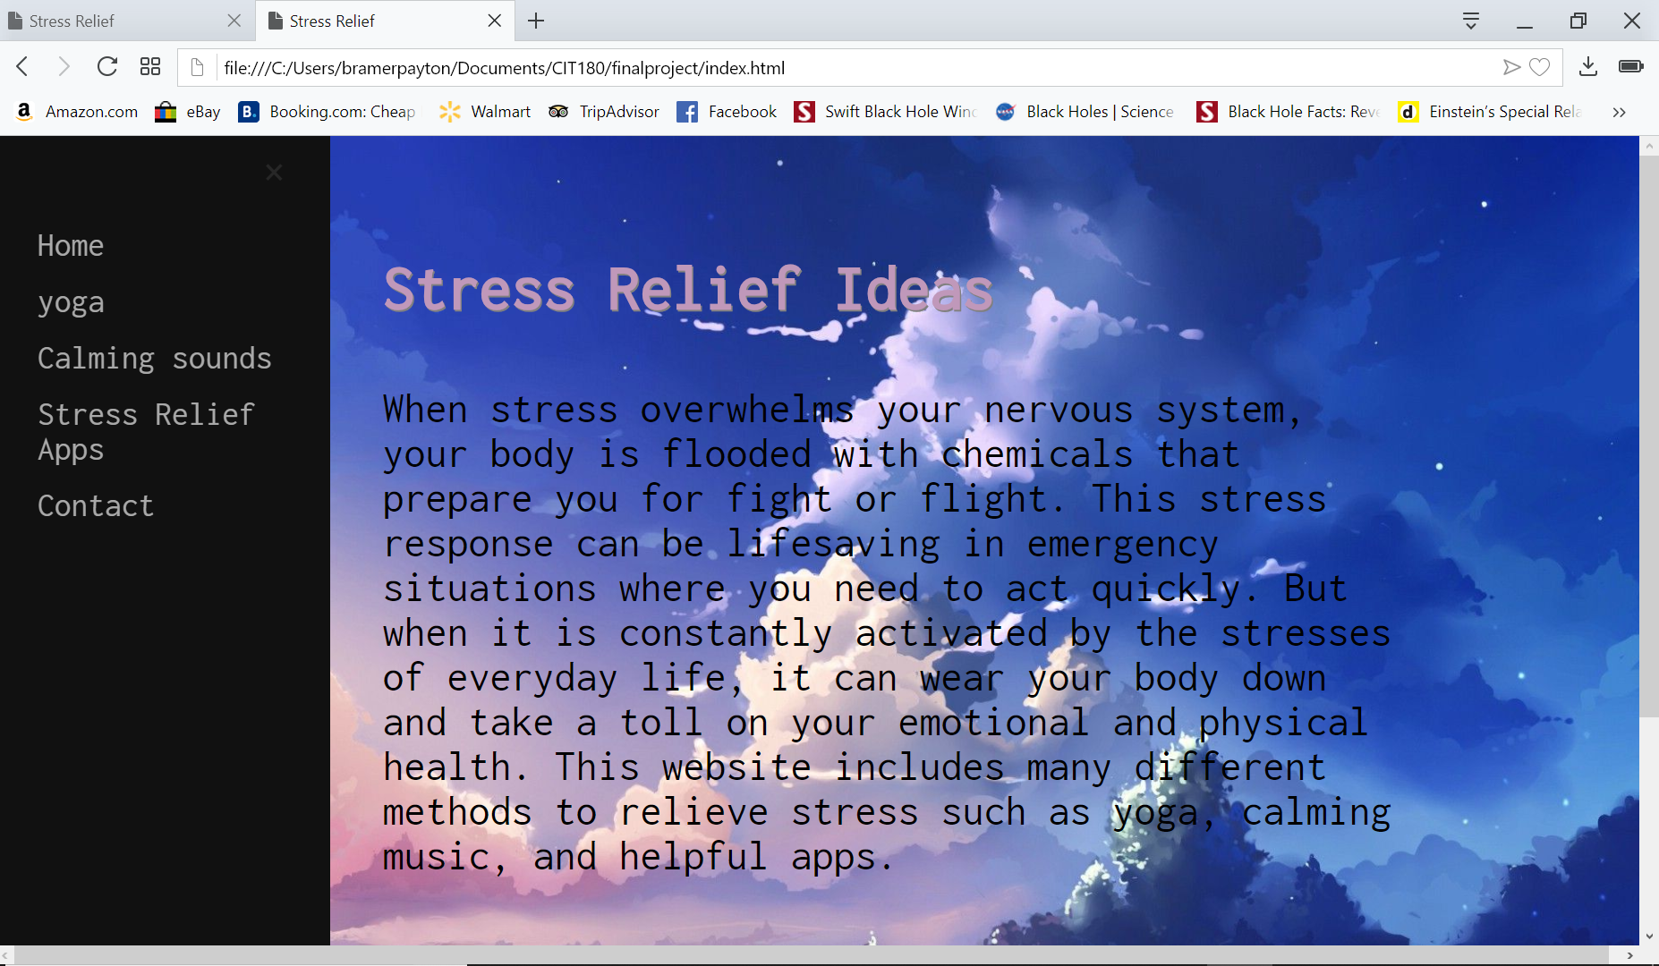
Any areas you feel you could improve upon ?
I feel like I had to use a lot of other assignments to help me. This makes me see that I need to work on coding without notes.
I need to work on some of the tags we don’t normally use like the bullet and numbering.
I need to work on CSS and JavaScript. I feel I still lack knowledge in reference to JavaScript and my CSS coding abilities are not super strong. Sometimes I forget all the areas of the website some of the blocks of code affect.

